Slide 1
Metadata spectrum

Slide 2
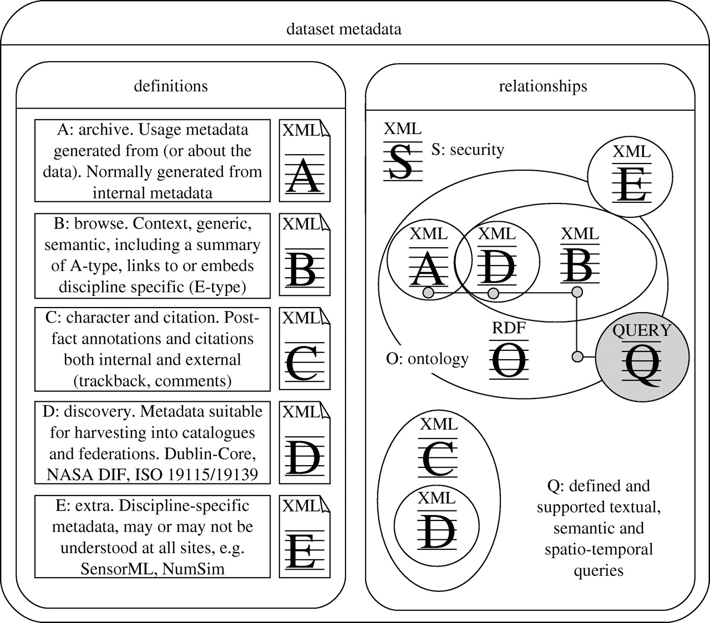
What activities does metadata support?
Management, archive, provenance
Search/discovery
Selection
Transformation
Analysis and use
Information in environmental data grids B.N Lawrence, R Lowry, P Miller, H Snaith, A Woolf Phil. Trans. Roy. Soc. A Published 13 March 2009.DOI: 10.1098/rsta.2008.0237

Slide 3
Application scope
Is this metadata standard/convention used:
primarily within one application or discipline?
across multiple domains?
Which catalogues or indexes does it feed?

Slide 4
Level of detail
Does this metadata standard/convention describe data:
primarily at the study/project/initiative level – used for discovery
At fine—grained variable level, with instruments, errors, protocol details ?
Which FAIR level does it address?

Slide 5
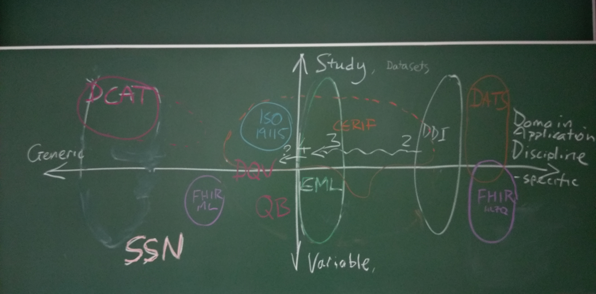

Slide 6
Study level
DCAT
DATS
EML
DDI
19115
CERIF
DQV
FHIR HL7Q
QB
SSN/SOSA
Generic applications
Primarily domain usage
Variable level

Slide 7
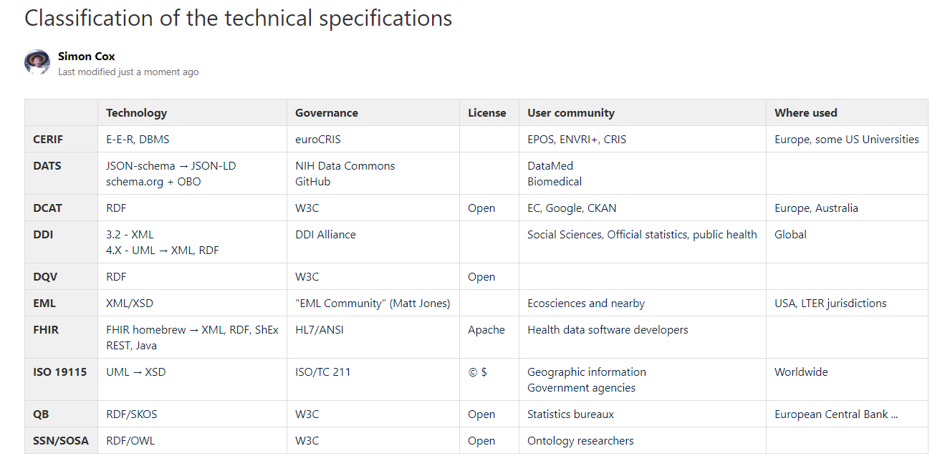

Slide 8
FAIR
Findable discovery, indexed
Accessible data service or protocol
Interoperable community formats and standards
Reusable licensed, curated

